Slide 1
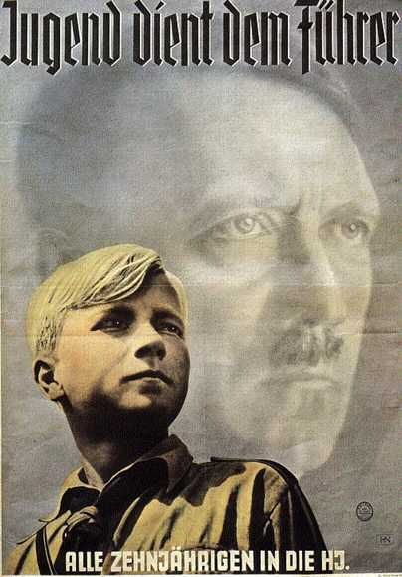
Youth & Education in Nazi Germany
How did the Nazis ensure that the youth of Nazi Germany were exposed to Nazi ideas?
How did they use the youth of Germany to spread Nazi values/ideas?

Slide 2
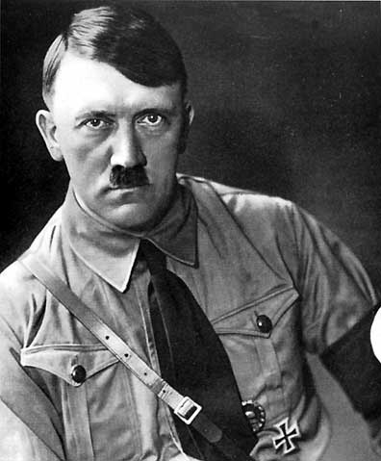
“In my great educative work I am beginning with the young. We older ones are used up… We are rotten to the marrow. But my magnificent youngsters! Are there finer ones in the world? With them I can make a new world.
My teaching is hard. Weakness has to be knocked out of them… A violently active, dominating, intrepid, brutal youth- that is what I am after… It must be indifferent to pain. There must be no weakness or tenderness in it…
I will have no intellectual training. Knowledge is ruin to my young men… One thing they must learn, self-command!” Hitler.

Slide 3
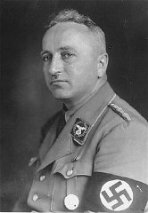
“We start our work when the child is three. As soon as it begins to think, a little flag is put into its hand. Then comes school, the Hitler Youth Movement, the Storm Troop… We never let a single soul go, and when they have gone through all that, there is the Labour Front, which takes them when they are grown up and never lets hold of them… whether they like it or not.”
Robert Ley, leader of the Labour Front (DAF)

Slide 4
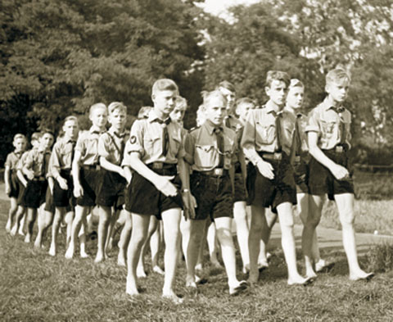
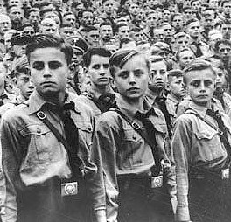
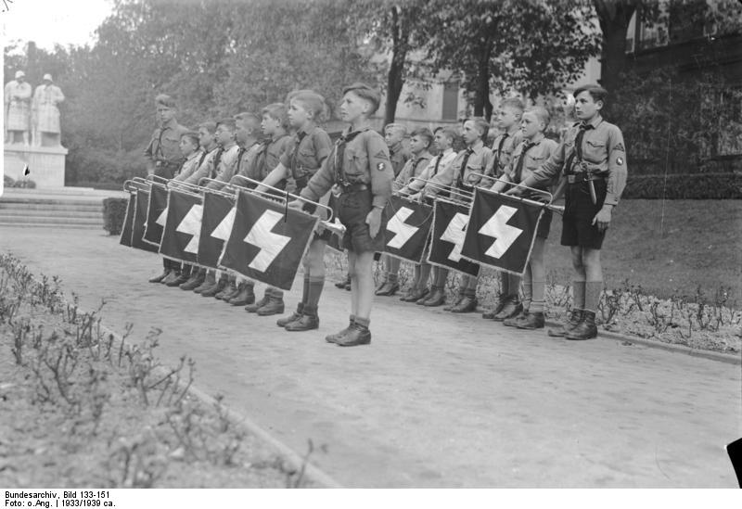
Boys:
6-10 Pimpfen (Cubs)
  Hiking, camping, physical exercise
10-14 Deutsches Jungvolk (Young German Boys)
  Oath of loyalty to Hitler- trained in military discipline
14-18 Hitler Jugend (HJ)- Hitler Youth
  More advanced military training

Slide 5
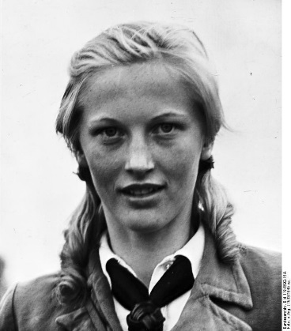
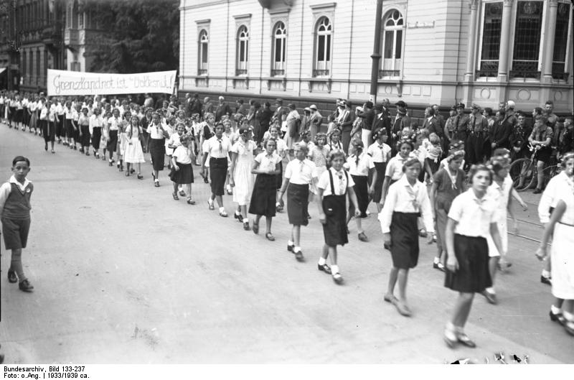
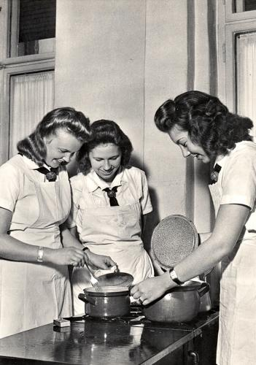
Girls:
10-14 Jung Madel (JM)- Young Girls
  Physical exercise
14-18 Bund Deutscher Madel (BDM)- League of German Girls
  Training for motherhood
18-21 Glaube und Schonheit- Faith and Beauty

Slide 6

Nazi aims for both boys and girls
Be obedient
Idolise the Führer
Be physically fit
Sacrifice self for the national good
Do everything possible to strengthen the heath and racial purity of the German nation
Girls
  Bear many children
Boys
  Be a strong fighter

Slide 7
How did the Nazis use youth movements to spread their values?
The school system
Youth groups
After leaving education and youth movements. They would join other Nazi organisations to ensure they did not escape control.
Idea? Hope that the influence of an array of institutions would outweigh influences from parents and the church (which may be hostile)

Slide 8
How do you convert a group in society to a way of thinking?
Offer exciting activities
= people more willing to listen to your broader aims
= Hitler Youth focused on offering fun and action to the young – camps, sports, military training
But… this was backed up by intimidation to persuade members to conform to all the state’s demands

Slide 9
Takeover
In 1933, all other youth organisations (except Catholic ones) were taken over by the Hitler Youth.
After 1936, all other youth organisations were banned.
Membership to the Hitler Youth became compulsory.

Slide 10
“What I liked about the Hitler Youth was the comradeship. I was full of enthusiasm… what boy isn’t fired by high ideals such as comradeship, loyalty, honour… The trips… off into the countryside… I was pleased that sport had its place…
Later, when I became a leader, the negative aspects became obvious. I found the compulsion and the requirement of absolute obedience unpleasant. It was preferred that people should not have a will of their own… The Hitler Youth was interfering everywhere in people’s lives…
In our troop the activities consisted almost entirely of boring military drill… why didn’t we complain to our parents and teachers? The explanation I can find is that we were all in the grip of ambition; we wanted to impress our sub-leaders with perfect discipline, with our powers of endurance with our military bearing.”

Slide 11
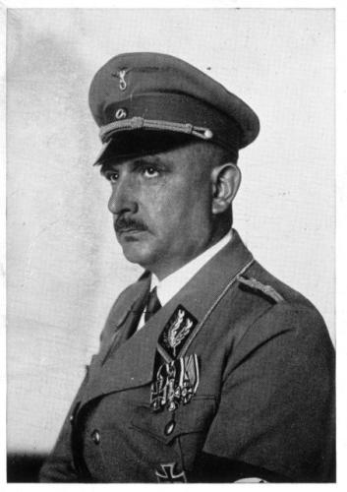
Education as propaganda
“The chief purpose of the school is to train human beings to realise that the State is more important than the individual, that individuals must be willing and ready to sacrifice themselves for Nation and Führer.”
Bernhard Rust- Nazi Education Minister

Slide 12

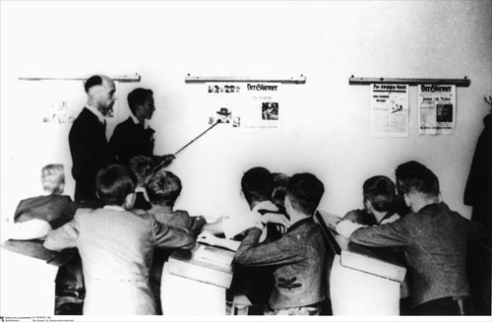
Teachers
By 1936, over 30% of teachers had voluntarily joined the Nazi Party.
To try and make sure that all teachers followed the ideals of the Party, they were pressurised into joining the National Socialist Teachers’ League (NSLB)
By 1937, 97% had done so.
Members had to attend a one-month training course- stressing Nazi ideology and physical education.

Slide 13
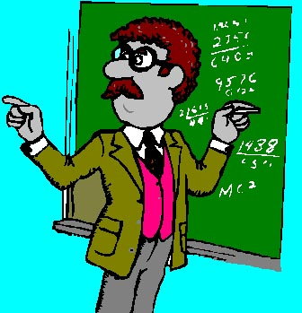

Teachers
Nazi officials kept records on individual teachers.
Those who were insufficiently committed to National Socialism could be dismissed.

Slide 14
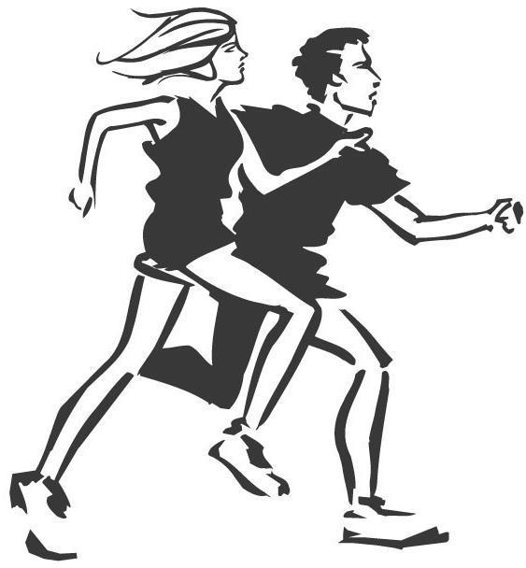
Curriculum
The Nazis changed the curriculum.
Greater stress was placed on physical exercise.
By 1936 this took up 2 hours a day.
Nazi ideas were incorporated into subjects, particularly biology and history.
From 1935, all textbooks had to be approved.
New textbooks were produced, reflecting Nazi values.

Slide 15
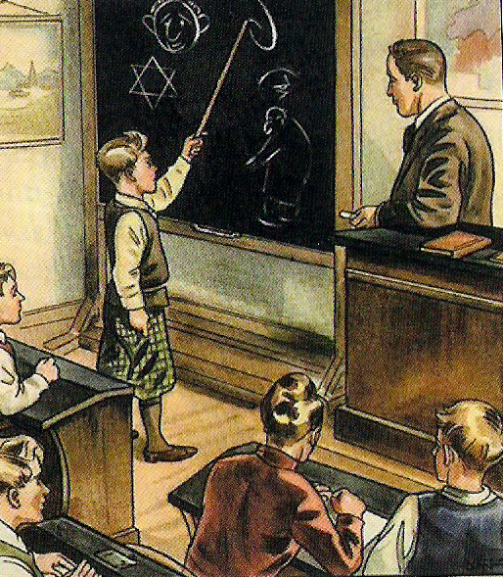
Biology
Race studies: all other races are inferior.
Nazi textbook image.
‘The Jewish nose is bent. It looks like the number six.’

Slide 16
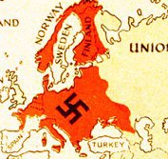
History
German view of history
World War One
Treaty of Versailles
Reich at centre of Europe

Slide 17
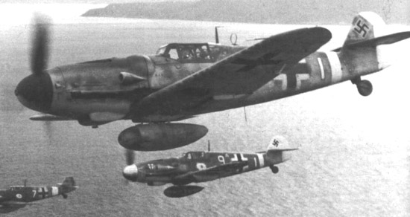
Maths
Reinforce Nazi ideas of conflict and struggle.
‘A squadron of 45 bombers drops bombs. Each bomb weighs 50 kilos. What is the total weight of bombs dropped?’

Slide 18
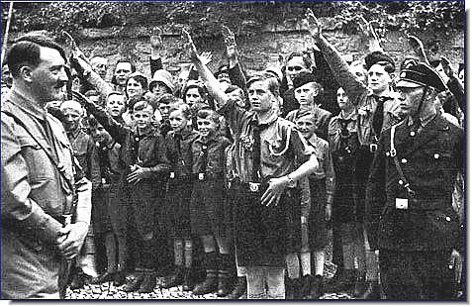
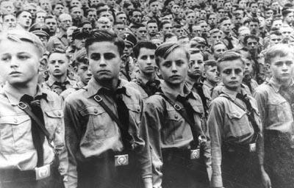
“There is no longer any intellectual freedom… and education is being degraded by political interference… Political agents, often ignorant and stupid men… interfere with my teaching of Geography. Some of them don’t seem to realise that any countries exist except Germany…
My headmaster; who is new and young and a very keen Nazi- in fact he would not have the post if he were not a Party man- greatly hopes that I will leave. That is obvious, for he will get high praise if he can quickly establish an all-Nazi staff.”
Dr Schuster, a geography teacher, 1938

Slide 19
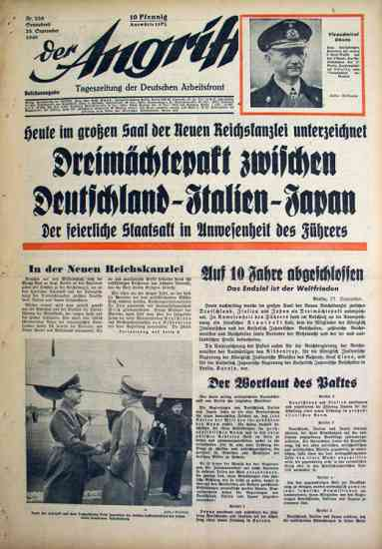
Der Angriff , 1939
“All subjects, German Language, History, geography, Chemistry and Mathematics- must concentrate on military subjects- the glorification of military service and of German heroes and leaders and the strength of a regenerated Germany. Chemistry will inculcate a knowledge of chemical warfare, explosives, Buna (artificial rubber), etc. while mathematics will help the young to understand artillery, ballistics etc.”

