Slide 1
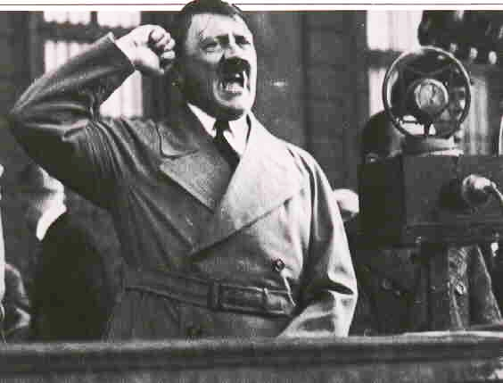
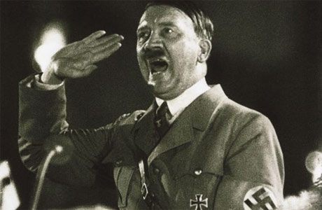
The Role of Hitler

Slide 2
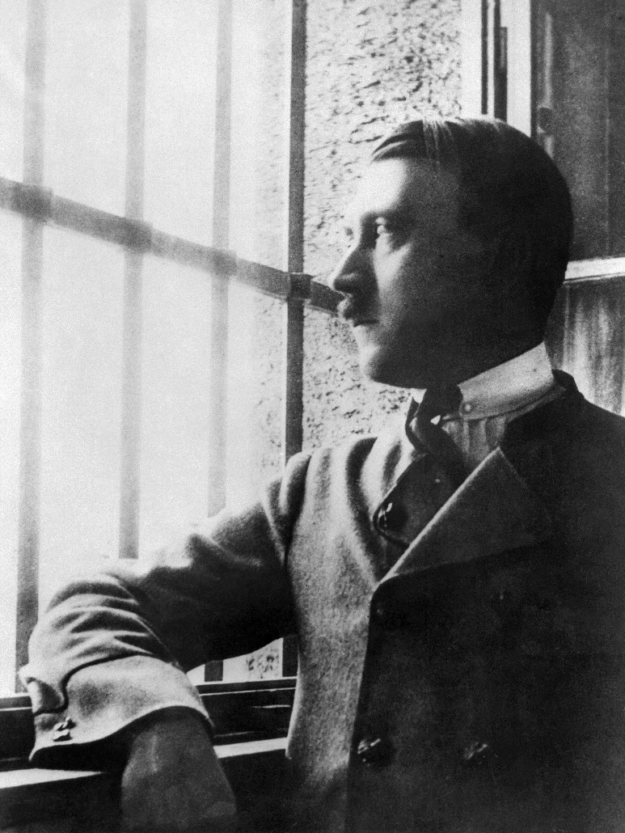
Hitler post Munich
In 1924 Hitler was in prison, sentenced to five years for treason.
His future looked bleak.
However, within a year he had been released and was able to turn his failure at Munich to his advantage.
He had gained national publicity from his bold defence at his trial.

Slide 3
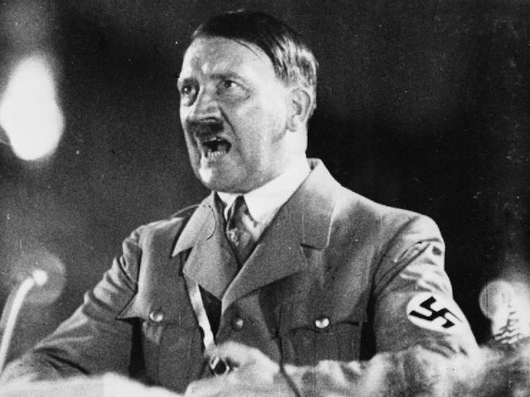
Hitler’s Appeal
Hitler was central to the success of the Nazis.
He provided charismatic leadership- felt an almost God-like responsibility to build a new Germany.
His willpower was infectious and inspiring.
He was a powerful speaker; his timing, expression and the content of his speeches impressed his listeners.

Slide 4
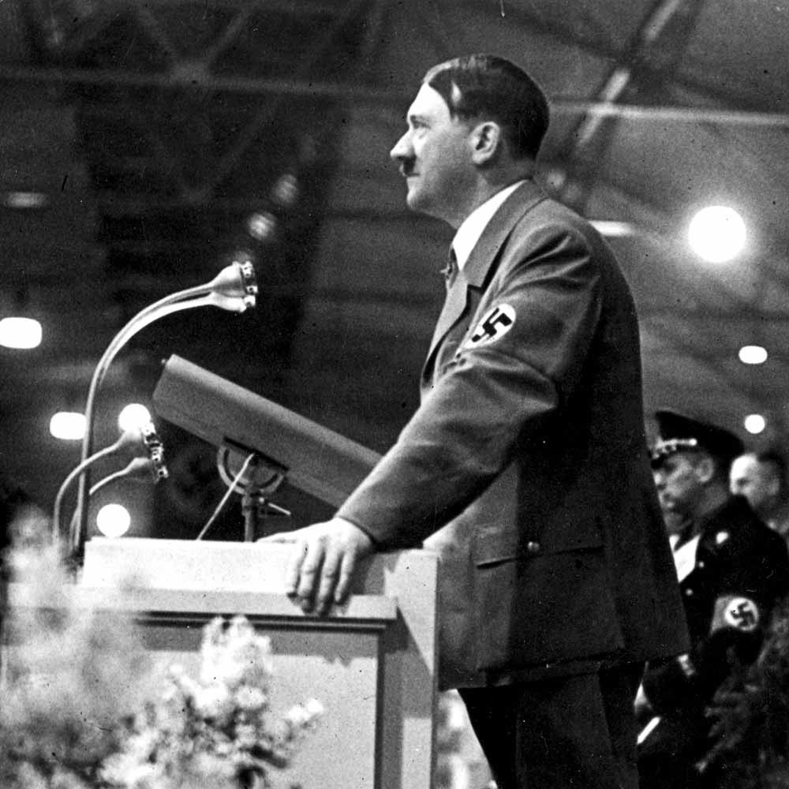
Skill as a speaker
Was able to fix his audience with his hypnotic stare.
He was able to identify with their emotions and expectations, and gave people faith.
This faith was attractive, particularly in the middle of the Great Depression, at a time when other parties lacked a sense of direction.

Slide 5
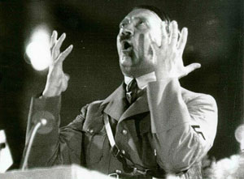
Hitler as a public speaker
Hitler was a natural orator.
His speeches were never logical or carefully argued.
He relied instead on stirring the emotions of his audience.

Slide 6
Politics is the art of using men’s weaknesses for one’s ends. Since the masses have only poor acquaintance with abstract ideas, their reactions lie more in the domain of feelings… And the driving force which has brought about the most tremendous revolutions on this earth has never been a body of scientific teaching which has gained power over the masses, but always a devotion which has inspired them, and often a kind of hysteria which has urged them into action. Whoever wishes to win over the masses must know the key that will open the door to their hearts.
Hitler, from Mein Kampf. 1925

Slide 7
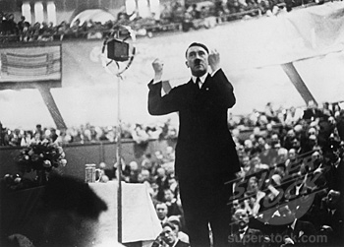
Practice
Like many good public speakers, Hitler prepared and practised his speeches, often in front of a mirror.

Slide 8
Adolf Hitler enters a hall. He sniffs the air. For a minute he gropes, feels his way, senses the atmosphere. Suddenly he bursts forth. His words go like an arrow to their target, he touches each private wound on the raw, liberating the mass unconscious, expressing its innermost aspirations, telling it what it most wants to hear… He is transformed into one of the greatest speakers of the century.
Otto Strasser, an early supporter of Hitler and a Nazi Party member. Disillusioned, he left in 1930.

Slide 9
Audience Manipulation
In November 1922, Truman Smith, an American spy based in Germany, wrote:
“The most important political force in Bavaria at the present time is the National Socialist German Workers Party....Adolf Hitler...is the dominating force in the movement....his ability to influence a large audience is uncanny”

Slide 10
Audience Manipulation
Karl Ludecke, who published a book called "I knew Hitler", wrote the following about the first time that he heard Hitler speak:
“Hitler was a slight, pale man with brown hair parted to one side. He had steel-blue eyes...he had the look of a fanatic....he held the audience, and me with them, under a hypnotic spell by the sheer force of his conviction”

Slide 11
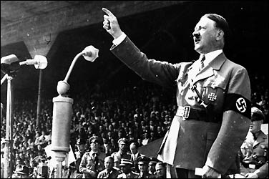
Hitler’s ability as a public speaker
His skill at public speaking had not helped him to become a national leader in the 1920s.
Why?
However, it was extremely useful in the political frenzy post 1929.
Why?

Slide 12
Hitler’s political sense
Hitler was able to recognise the opportunities the Depression brought about.
He recognised that the Weimar Government, with its system of coalitions, could be exploited by a rising party.
He could see the weaknesses of his opponents and was able to use them to his advantage.

Slide 13
Undisputed Party Leader
The Nazi Party was not a democratic organisation.
Leader was not elected.
Position was gained and maintained by force of will alone.
Was this a sign of power?
Much needed post WW1/Depression?
Cult of the leader = propaganda to build his personal cult status.

