Slide 1

The Appeal of the Nazis after 1929

Slide 2
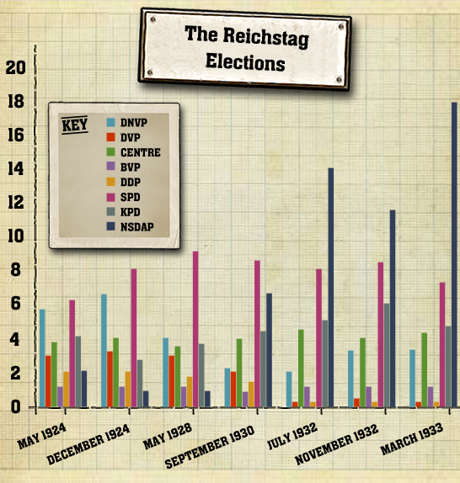
The appeal of the Nazis after 1929
Nazi representation in the Reichstag had risen from 12% in 1928 to 37% by 1932.
Why were more Germans voting for the Nazi Party?
Who was voting for the Nazi Party?

Slide 3
What groups did the Nazis appeal to?
After the Wall Street Crash and during the Great Depression which followed, Nazi ideas took on a special relevance.
Is the Weimar government indecisive? Then Germany needs a strong leader!
Are reparations adding to Germany’s problems? Then kick out the Treaty of Versailles!
Is unemployment a problem? Let the unemployed join the army, build Germany’s armaments and be used for public works like road building

Slide 4
Who voted for the Nazis?
Nazi ideas were very attractive to the most vulnerable groups: the unemployed, the elderly and the middle-classes.
Hitler offered them someone to blame for Germany’s troubles- the Allies, the ‘November Criminals’, and the Jews.
None of these messages was new- and can be traced to the 25 point Party Programme (1920) and Mein Kampf (1926).
They had not won support for the Nazis in the Stresemann years.
The difference now was that the democratic parties simply could not get Germany back to work.

Slide 5

Who voted for the Nazis?
The Nazis did best in small towns and in the countryside.
They did well here because they were able to offer something to most people.
In some of cases over 80% of people in these areas voted for the Nazi Party.

Slide 6

Who voted for the Nazis?
As well as capitalising on the economic crisis, the Nazis had a widespread appeal to a cross- section of society:
Farmers: Faced bankruptcy and land losses due to economic crisis .
The Nazis promised to tackle the banks and ensure fairer prices for produce.

Slide 7
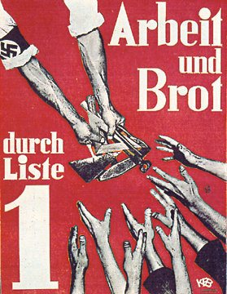
Which groups did they appeal to?
Consumers: The Nazis promised cheaper food prices! (Contradicts promise to farmers!)
Workers: The Nazis promised to create jobs and give workers a fairer share of the national wealth.

Slide 8

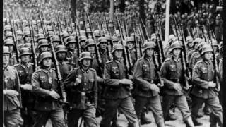
Which groups did they appeal to?
Businessmen: The Nazis promised to destroy Communism and to limit the power of trade unions.
The Army: The Nazis promised to abolish the Treaty of Versailles and begin rearmament.
The Middle Classes: The Nazis offered to destroy Jewish banks and promised to restore prosperity to the middle classes.

Slide 9

Which groups did they appeal to?
The Young: Unemployment in Germany had hit school leavers hard and there seemed to be no hope. The Nazis offered the young the promise of a better future.

Slide 10

Summary of Nazi appeal
The Nazis had widespread appeal and promised to solve the problems facing many sections of society.
While they were very skilled at delivering these messages to specific groups, they were vague about how they would actually achieve this.

