Slide 1
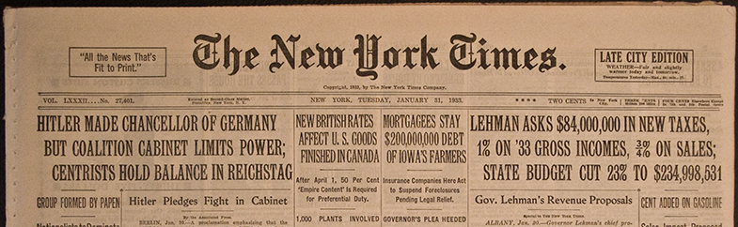
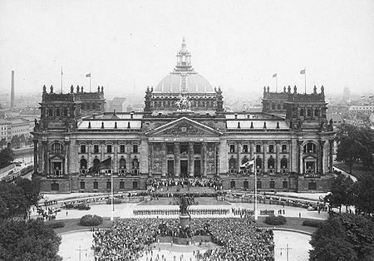
How did Hitler become Chancellor in 1933?
How did the breakdown of the Weimar Government contribute to the rise of the Nazi Party?

Slide 2
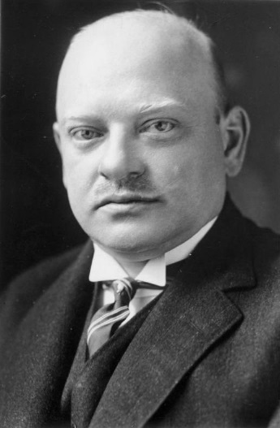
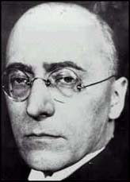
Democracy Starts to Crack
In October 1929 Stresemann died.
Under his leadership, and during his time as Foreign Minister, there had been relative stability in Weimar.
In 1930 President Hindenburg appointed Heinrich Brüning as Chancellor.
The Reichstag became split over policies.
Stresemann
Brϋning

Slide 3
Trouble in Weimar Republic
For the next two years Brϋning and his advisers tried to govern without a majority vote.
He asked Hindenburg to use his emergency powers to pass laws without them having to go through the Reichstag.
Between 1930-32 the Reichstag sat less often and became more and more helpless.

Slide 4
Result of Political Crisis
Laws issued using Article 48
Reichstag: Days sitting
1930: 5
1931: 44
1932: 66!
1930: 94
1931: 42
1932: 13

Slide 5
Result?
Democratic parties could not agree on how to deal with Germany’s problems.
Most people lost faith in democracy.
Reichstag became less and less democratic.
DICONTENT GREW

Slide 6
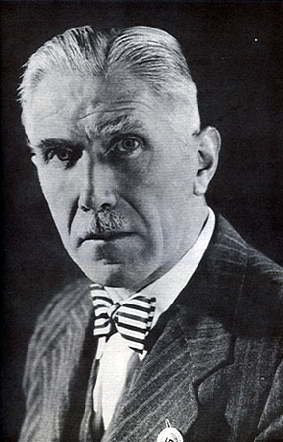
Weimar Politicians
1932 Franz von Papen replaced Brüning as Chancellor.
Only lasted 6 months!
Von Papen struggled as he had no majority in the Reichstag and relied entirely on Presidential decree.
Franz von Papen

Slide 7
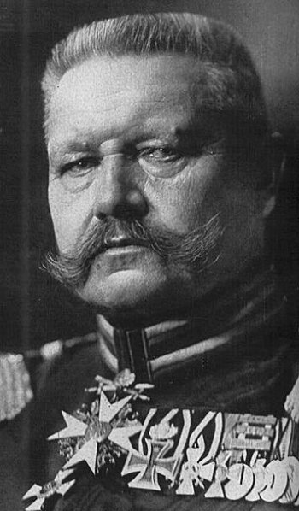
President Hindenburg
Elected as President twice.
Was re-elected in 1932, mainly with the support of those who saw him as a protection against Nazi lawlessness and brutality.
By 1932 was old man- 85!
President Hindenburg

Slide 8
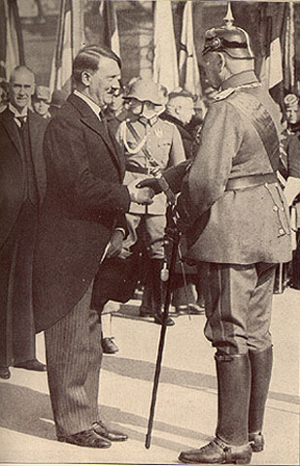
Paul von Hindenburg
He feared that Hitler was a threat to democracy.
Wrote to Hitler ‘a cabinet led by you would develop into a dictatorship’.
Yet, Hindenburg's own supporters thought the Nazis could be useful - albeit unpleasant – and were worth accommodating.

Slide 9
Hindenburg
The Nazis were now the largest party in the Reichstag with 37% of vote.
Hitler was now in a position to demand the Chancellorship of the Reichstag.
Hindenburg refused and Hitler declared that he would not bring his party into a Government for anything less than himself as Chancellor.
Despite considerable pressure, Hindenburg refused to appoint him.

Slide 10
Von Papen & Hitler
Nazis won 230 seats out of 608 in 1932.
Became very useful to von Papen, hoped he could control Hitler and use Nazi support to increase his own power.
‘In six months we’ll have pushed Hitler so far into a corner he will be squealing.’
Offered Hitler the job of Vice Chancellor.
Hitler refused, did not want to be linked to Von Papen’s failing system.

Slide 11
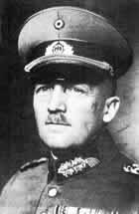
Hitler’s Rise to Power
Von Papen had enemies.
General Kurt von Schleicher replaced him as chancellor in 1932 (lasted 2 months!)
He tried to limit the activities of the Nazi Party, in return the Nazi’s allied themselves with von Papen’s party to defeat von Schleicher in the Reichstag.

Slide 12
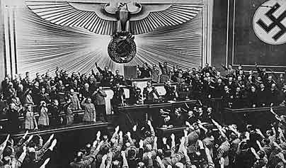
Hitler’s Rise to Power
With support from industrial leaders, von Papen persuaded Hindenburg to appoint Hitler as Chancellor.
Hitler became Chancellor on the 30th January, 1933.

Slide 13
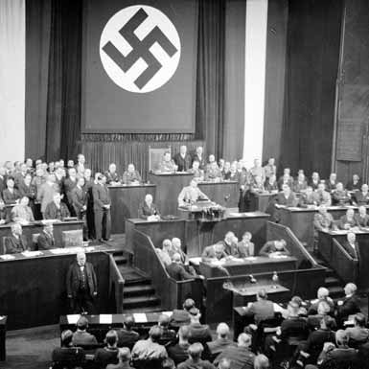
Rise to Power
Hitler in full control?
Few Nazi’s in coalition government.
Hindenburg had the power to get rid of Hitler at any time.

