Slide 1
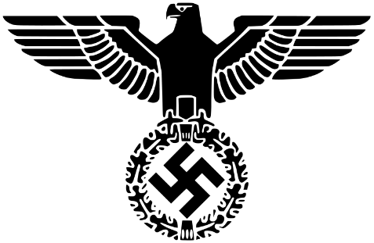
Fear and State Terrorism
How did the Nazis use fear and terror to stay in power, 1933-39?

Slide 2
Repression and control in Nazi Germany
There was supposed to be no room for opposition of any kind in Nazi Germany.
The aim was to create a totalitarian state.
In a totalitarian state there can be no rival parties, no political debate.
Ordinary citizens must put all of their energy into serving the state and obeying its leader wants.
The Nazis established a range of organisations they used to control Germany.

Slide 3
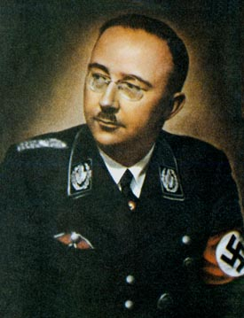
How were the police organised in Nazi Germany?
Until 1933 each state in Germany had its own police force.
By 1936 separate forces were centralised under Himmler as Chief of Police.
Heinrich Himmler

Slide 4
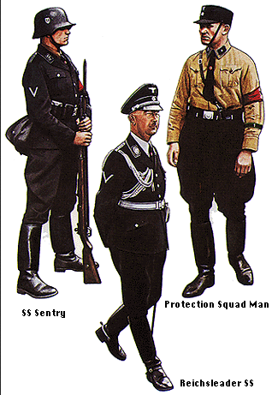
How were the police organised in Nazi Germany?
The police force was divided into a number of different agencies, each with its own powers:
  Waffen SS
  Kripo (Criminal police)
  Gestapo (Secret State Police)
  SD (Security Service- foreign and domestic intelligence)

Slide 5
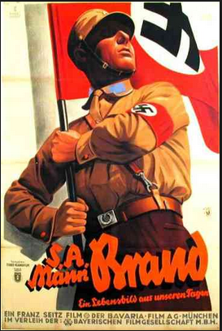
The SA
After the Night of the Long Knives, the SA was disarmed + restructured.
The SA became a less important organisation than it had been.
However, it remained a force which could be used to intimidate opposition.
It also remained a visible presence on the streets.

Slide 6
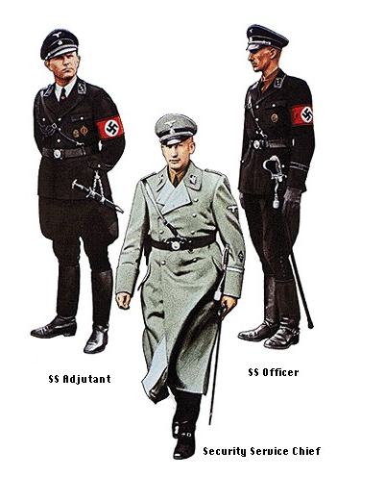
SS (Schutzstaffel)
The SS was main organisation used to instil fear and terror among the German population.
It was created in 1925.
The SS began as Hitler’s elite bodyguards but became a large organisation which carried out many different jobs.

Slide 7
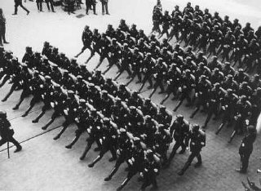
SS (Schutzstaffel)
The SS:
Helped root out enemies of the state.
Carried out the racial policies of the party.

Slide 8
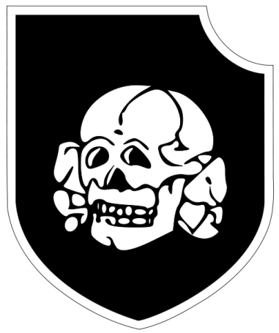
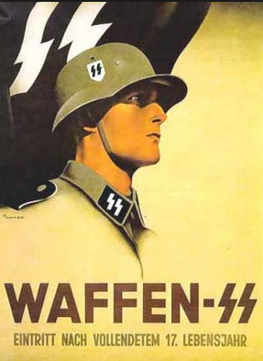
SS
Two important sub-divisions of the SS were the Death’s Head units and the Waffen-SS.
The Death’s Head units were responsible for the concentration camps and the slaughter of the Jews.
The Waffen-SS were special SS armoured regiments which fought alongside the regular army.
Death’s Head Units- collar insignia

Slide 9
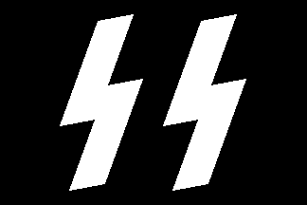
The SS
In 1929 there were only 280 members.
By 1930: 50,000
By 1933: 240,000
Alongside the Gestapo, the SS was the most powerful and feared force in Nazi Germany.

Slide 10
Impact?
Between 1933-1939 around 250,000 Germans were convicted and imprisoned for political crimes.
By 1939 another 162,000 were in ‘protective custody’ without trial.
The SS later took on the responsibility for concentration camps and extermination camps.

Slide 11
The Gestapo (Secret State Police)
The Gestapo was originally the Prussian secret state police, eventually it covered all the German states.
In 1933 SS leader Himmler was appointed as head of the Gestapo, so it came under SS control.
From 1936 it became the most important security agent of the state.
The Gestapo was able to decide for itself what the law was.

Slide 12
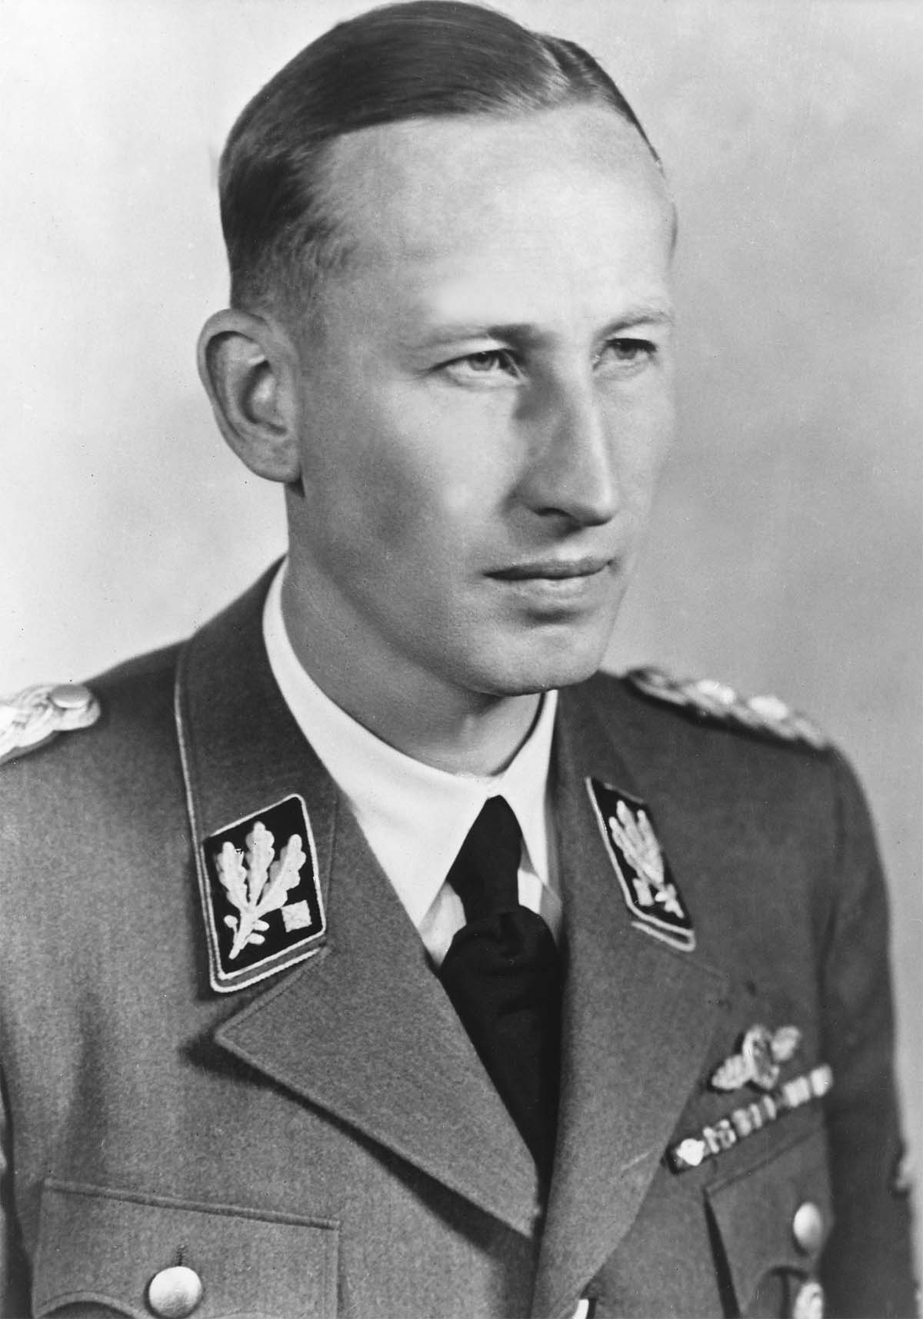
The Gestapo (Secret State Police)
The Gestapo could arrest citizens and send them to concentration camps without trial, or even an explanation.
Reinhard Heydrich
(Commander of the Gestapo)

Slide 13
The Gestapo
“Never before, in no other land and at no other time, had an organisation attained such a comprehensive penetration [of society], possessed such power, and reached such a degree of ‘completeness’ in its ability to arouse terror and horror, as well as in its actual effectiveness.”
Historian Jacques Delarue, 1994

Slide 14
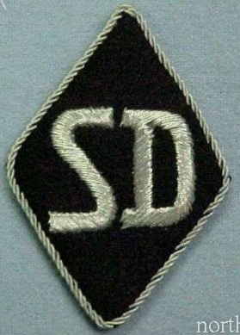
SD (Security Police)
The SD was the internal security/intelligence service of the SS.
It was led by Heydrich.
It was the elite of the elite.

Slide 15
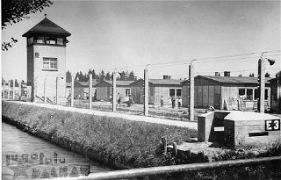
Concentration Camps
Concentration camps were set up almost as soon as Hitler took power.
The first camps in 1933 were meant to be temporary prisons.
At first they were built in disused factories and warehouses.
Soon they were purpose built.
Dachau

Slide 16
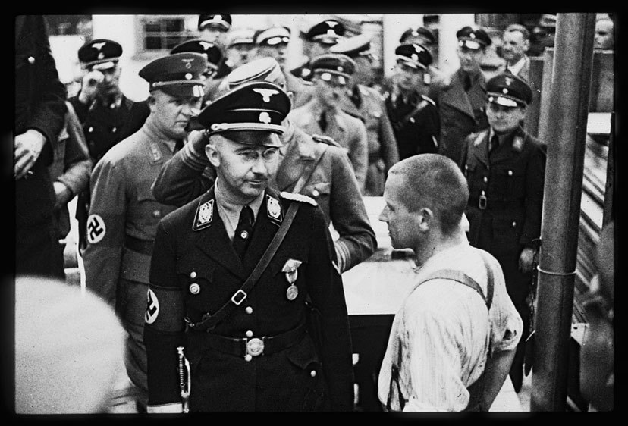
Concentration Camps
These camps were usually in quiet rural areas.
They were run by the SS Death’s Head units.
Prisoners were forced to do hard labour.
Food was very limited and prisoners suffered from harsh discipline, beatings and random executions.

Slide 17
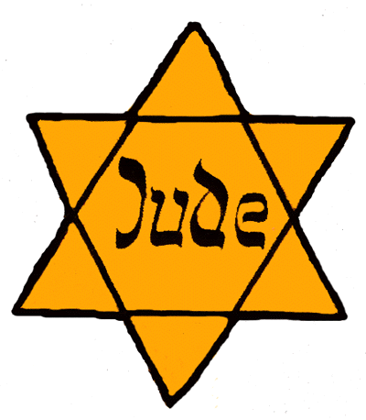
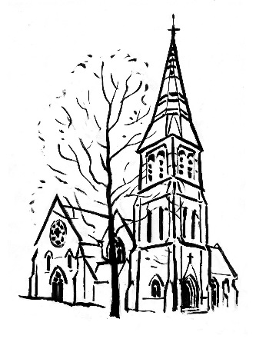


Concentration Camps
By the late 1930s deaths in the camps became increasingly common.
Very few people came out alive.
Jews, Socialists, Communists, trade unionists, churchmen and anyone else brave enough to criticise the Nazis ended up there.

Slide 18
Fear and State Terrorism
The brutality of the Third Reich must not be underestimated.
Basic individual freedoms were removed in 1933.
Thousands of Germans were rounded up into concentration camps.
Anyone that the Nazis viewed as outsiders were imprisoned, sterilised and eventually murdered.
There was no-one and nowhere for people to turn to in order to gain protection from the Nazi regime.

