Slide 1
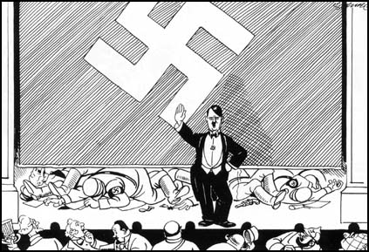
Nazi Consolidation of Power
How did the Night of the Long Knives help to consolidate Hitler’s position
Notes:
<number>

Slide 2
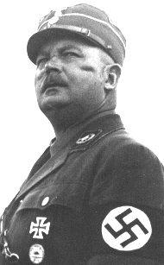
Hitler and the SA
Hitler now had total political power.
However, he feared the power of the regular army.
Röhm (leader of the SA) planned to merge the regular army with the SA = all Germany’s soldiers under his control.
Hitler was afraid that Röhm was becoming too powerful.
He was also worried that army leaders might try to lead a revolution against the Nazis.
Röhm
Notes:
<number>

Slide 3
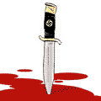
The Night of the Long Knives
On 30 June 1934, Hitler ‘removed the problem’ of the SA.
= the most dramatic and most significant single event during the establishment of Hitler’s supremacy.
Notes:
<number>

Slide 4
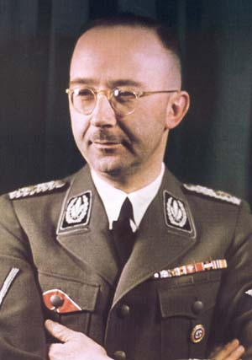
Victims?
The main victims were the leaders of the SA.
Now Hitler had power, he was in less need of these potentially dangerous troops.
Dazed SA leaders were woken up, dragged from their beds, taken to Nazi HQ and gunned down.
At the same time, in Berlin and other cities, the SS (Schutzstaffel) moved on other potential threats to Hitler.
Himmler- leader of the SS
Notes:
<number>

Slide 5
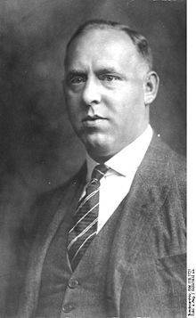
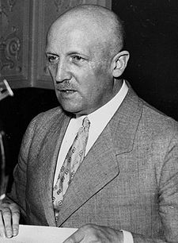
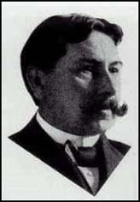
Victims
Gregor Strasser (rival of Hitler, had been offered the Vice-Chancellorship by von Schleicher)
Von Schleicher
Röhm
von Kahr
An estimated 1000 people were killed (including 50 SA leaders)
Notes:
<number>

Slide 6

Hitler’s Regime Strengthened
Main victims = SA
The SA were feared by the conservative elite and resented by the Germany army.
Now in power, Hitler needed the support of the elite far more than he needed the SA.
Notes:
<number>

Slide 7
Remove potential threats
Ended Nazi in-fighting.
Röhm and Hitler had different views of the SA.
Röhm felt it should play a central role in seizing and maintaining power.
Hitler felt it should have a lesser role to play in the Party.
Hitler claimed he was defending Germany against a plot by Röhm.
Himmler wanted his SS to break away from the formal control of the SA.
Notes:
<number>

Slide 8
Getting Away with Murder
Why was Hitler able to get away with murder in the Night of the Long Knives?
Justifiable act of self-defence by the state?
“Everyone will know in future that if he lifts his hand against the state certain death is his fate, and every National Socialist will know that no rank and no position allows him to escape punishment... If anyone reproaches me and asks why I did not resort to the regular courts of justice for the conviction of the offenders, then all I can say to him is this: in this hour I was responsible for the fate of the German people, and thereby became the Supreme Judge of the German people…”
Notes:
<number>

Slide 9
The Führer with soldierly decision and exemplary courage has himself attacked and crushed the traitors and murderers. The army, will show its gratitude through devotion and loyalty.
Defence Minister, 5/7/34
Through your decisive intervention and your courageous personal commitment you have nipped all the treasonable intrigues in the bud. You have saved the German nation from serious danger and for this I express to you my deeply felt gratitude and my sincere appreciation.
Hindenburg
The main thing is he has freed us from the Marxists [and has] got rid of the harmful influence [of the] dreadful SA… even if he is a mass murderer.
A small businessman
Notes:
<number>

Slide 10
“After June 30th everyone was frightened. Everyone felt that he in turn might share the fate of the SA men. The name of Himmler sent shivers down the spine… The ordinary German no longer felt free.”
A German citizen interviewed in the 1980s
Notes:
<number>

Slide 11
Significance?
Marked major shift in the development of Hitler’s dictatorship.
He had managed to tame the radicals in the SA and win over the support of the elite, importantly the army.
Hindenburg died in August 1934.
Hitler takes over as Führer- Chancellor and President in one.
After his death, all soldiers took a new oath of personal loyalty to their Führer.
Notes:
<number>

Slide 12
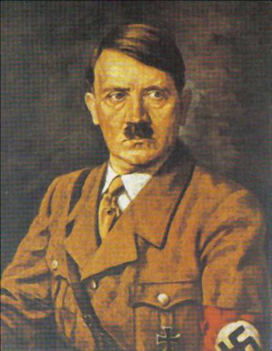
Importantly
Hitler had gained the legal acceptance of the murder of opponents.
= intimidated future opponents and increased Hitler’s confidence and strength.
Most German people accepted the view that as their Führer, Hitler would only act for the good of the nation.
Notes:
<number>

Slide 13
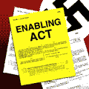
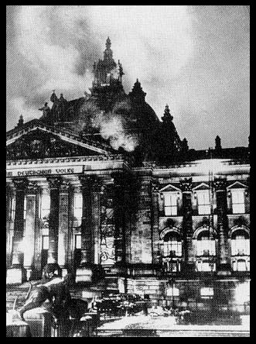
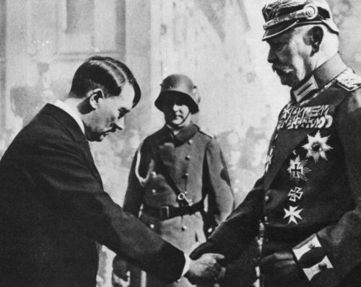
Steps to dictatorship
As leader of the largest party in the Reichstag Hindenburg finally agrees to make Hitler Chancellor
30th June 1934 Night of the Long Knives. Around 500 of Hitler’s opponents are murdered. Including Rohm
After the elections of March 1933, the Nazi Party pass the Enabling Act on the 23rd March. Gave Hitler and his Cabinet the ability to pass laws without needing Reichstag approval. Hitler quickly BANS all other political parties and imprisons political opponents
Reichstag Fire 27 February 1933
Hitler’s excuse to ban the Communist Party and issue the Reichstag Fire Decree
30 Jan 1933
Notes:
<number>

Slide 14
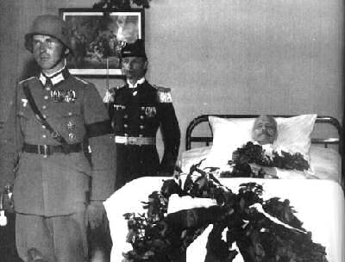
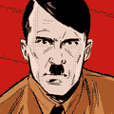
Steps to dictatorship
2nd August 1934
President Hindenburg dies = final barrier to total power removed
Hitler now Führer of Germany. Declares himself jointly president, chancellor and head of the army
Notes:
<number>

