Slide 1
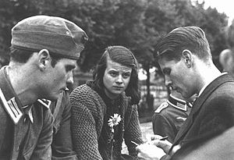
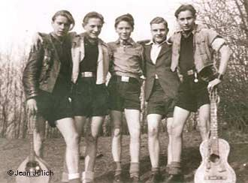
Co-operation and Opposition in Nazi Germany
Was there much opposition to Hitler and the Nazis, 1933-39?

Slide 2
Why was there little opposition?
The Nazis faced relatively little open opposition during their 12 years in power.
Privately, many complained about the regime:
  Some refused to give the Nazi salute
  Some told anti-Nazi jokes and rude stories about senior Nazis
  Importantly, criticism was always done in private

Slide 3
Why was there little opposition?
Terror!
Most were too afraid to speak out openly against the Nazi regime.
All the Nazis main opponents had been killed, exiled, or put in prison.
However, there are some factors which can be used to explain why there was such little opposition.

Slide 4
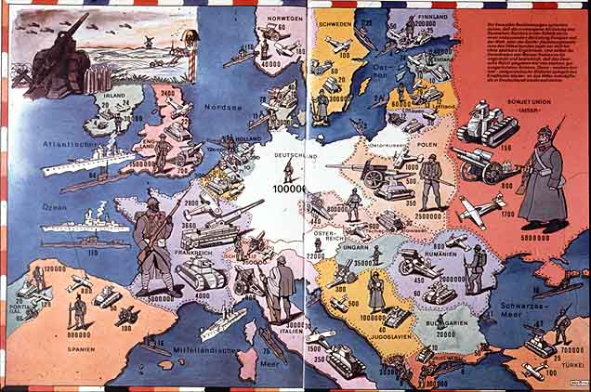
Nazi Successes
Many admired and trusted Hitler.
Some were prepared to tolerate the terror of Nazi rule, and to abandon their rights to political freedom and free speech, in return for work, foreign policy success, and strong government.

Slide 5
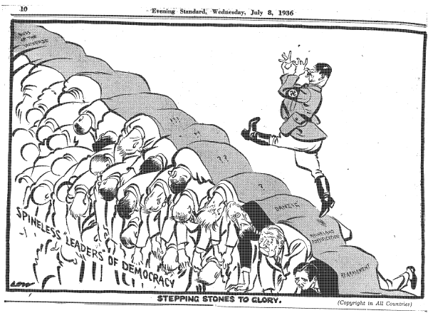
Nazi Successes
The apparent economic success of the regime pleased many.
Many felt that the Nazis were bringing discipline, order and tradition values back to Germany.
Foreign policy successes between 1933-39 made many Germans feel a sense of national pride once again.
For many Germans, they may not have liked the methods of the Nazis, but they felt the ends justified the means.

Slide 6
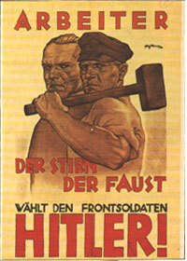
Economic Fears
Workers lived in fear of speaking out in case they lost their job.
“The average German worker is primarily interested in work and not in democracy. People who previously enthusiastically supported democracy showed no interest at all in politics. One must be clear about the fact that in the first instance men are fathers of families and have jobs, and that for them politics takes second place and even then only when they expect to get something out of it.”
A report by a Socialist activist in Germany, February 1936.

Slide 7

Economic Fears
After the effects of the depression many were terrified by the prospect of being out of work again.
Businesses that did not contribute to Nazi Party funds risked losing Nazi business and going bankrupt.
So, for some, conforming was an act of self-defence.

Slide 8
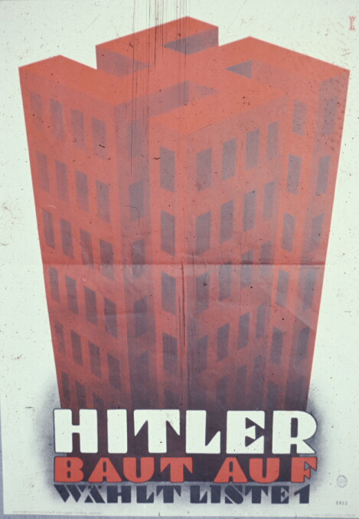
Propaganda
The Nazi propaganda machine underpinned the whole regime.
This ensured that many Germans found out very little about the bad things that were happening.
Or, if they did they only heard them with a positive, pro-Nazi slant.
“Hitler Builds.”

Slide 9
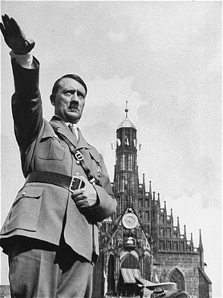
Lack of Christian opposition
What about the Church?
Why did the Church choose to believe Hitler’s promises?
Watch the following clip about lack of opposition from the Church

