Slide 1
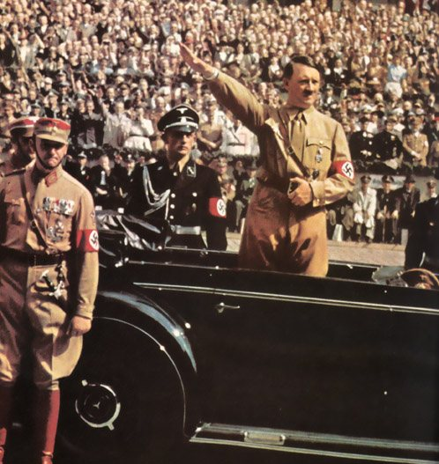
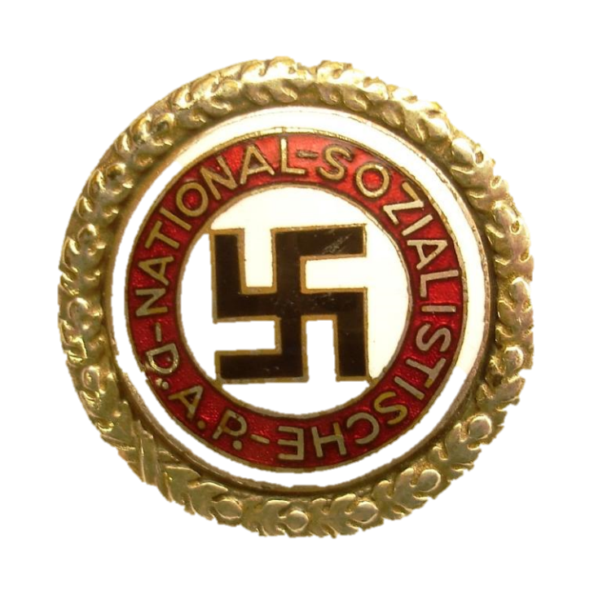
Who was Hitler? Who were the Nazis?

Slide 2
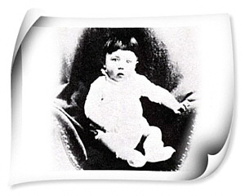
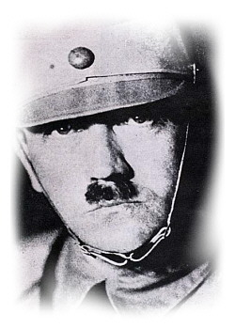
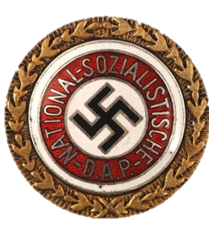
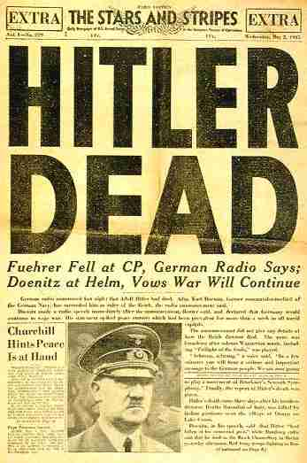
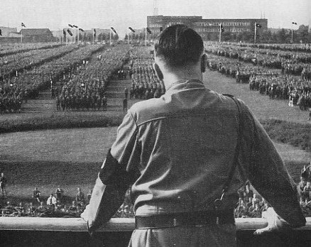
Hitler Timeline
1889: Born in Austria
1914: Joined the German Army. Age 25
1920: Leader of the NSDAP. Age 31
1933: Chancellor of Germany. Age 43
1945: Dead. Age 56

Slide 3
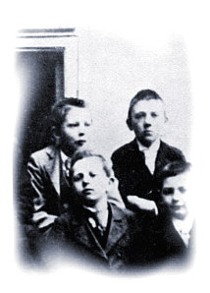
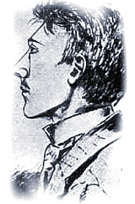
Hitler’s early years
Young Adolf attended church regularly and sang in the local choir.
He grew up with a poor record at school and left at the age of 16.
His ambition?
To become an artist or architect.

Slide 4
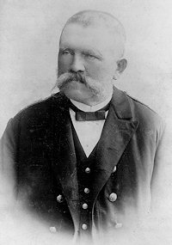
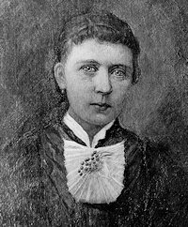
Hitler’s Family Life
Hitler’s father died when Adolf was thirteen.
His mother brought up Hitler and his sister alone.
She too died when Hitler was 18.
Hitler’s parents

Slide 5
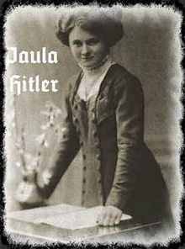
Early life
"Adolf challenged my father to extreme harshness and got his sound thrashing every day. He was a scrubby little rogue, and all attempts of his father to thrash him for his rudeness were in vain. How often on the other hand did my mother caress him and try to obtain with her kindness where the father could not succeed with harshness ..."
Hitler’s father was very strict and had a difficult temper.
Adolf bore the brunt of his father’s temper.
His sister Paula said:

Slide 6
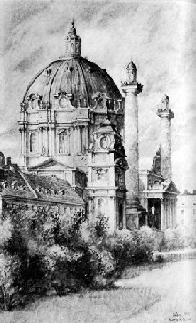
Hitler the artist
In 1907 Hitler moved to Vienna, the capital of Austria, where the Vienna Academy of Fine Arts was located.
Hitler took the entrance examination in a bid to fulfil his dream of becoming a painter.
He was eighteen years old and full of high hopes.
To his own surprise he failed to get admission.
After trying again and failing, within a year he was living in homeless shelters and eating at charity soup-kitchens.

Slide 7
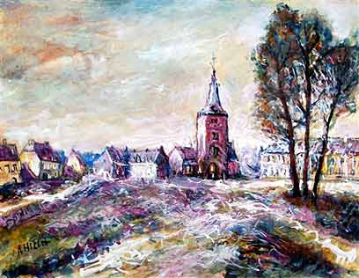
Vienna
In Vienna Hitler spent his time reading anti-Semitic tabloids and pamphlets.
He took occasional unskilled jobs and sold some of his paintings or advertising posters whenever he could.

Slide 8
Character & beliefs
At this time Hitler began to show traits that would characterise his later life:
An inability to establish ordinary human relationships
Intolerance and hatred, especially of the Jews
A readiness to live in a fantasy-world so as to escape his failure

Slide 9
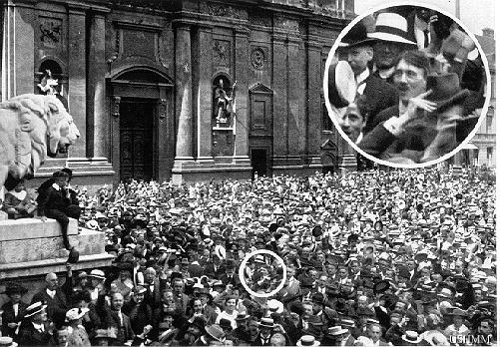
War declared!
Hitler’s life changed with World War One.
World War One was a welcome event which gave him some purpose in life.
Hitler in Munich joining the crowds greeting news of the outbreak of war.

Slide 10
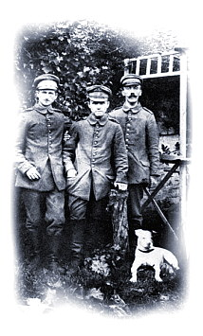
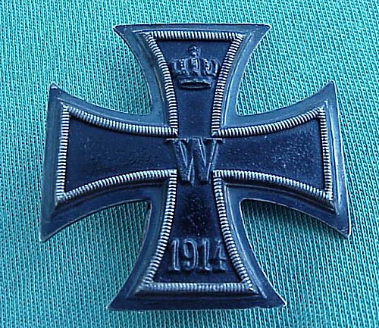
World War One
Hitler moved to Munich in 1913.
He joined the German Army and served as a corporal on the Western Front.
He was wounded and temporarily blinded after a gas attack.
He received medals for bravery and service, including the Iron Cross.
He believed passionately in Germany and was devastated when they lost the war.

Slide 11
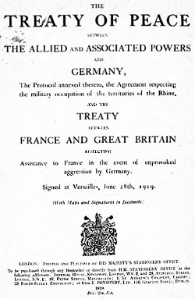
After the war: Negotiating the Peace
The Versailles Treaty that ended the war stripped Germany of much of its territory, forced the country to disarm, and ordered Germany to pay huge reparations.
When the army returned to Germany the country was in despair.
Germany was bankrupt and millions of people were unemployed.

Slide 12
Hitler’s response to the Treaty
Hitler felt Germany had been betrayed at Versailles by the ‘November Criminals’ (the German politicians who signed the Treaty).
Hitler blamed the new government for Germany’s defeat in the war and for signing the Treaty.
Hitler would later use the Treaty during his rise to power as a means to gather support against the government.
Destruction of Versailles = central feature of Nazi propaganda

Slide 13
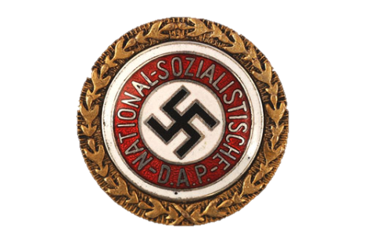
After the War
In 1920, Hitler joined the National Socialist German Workers Party (NSDAP), later known as the Nazis.
Aims:
The Nazis called for all Germans, even those in other countries, to unite into one nation
They called for a strong central government
They called for the cancellation of the Versailles Treaty

Slide 14
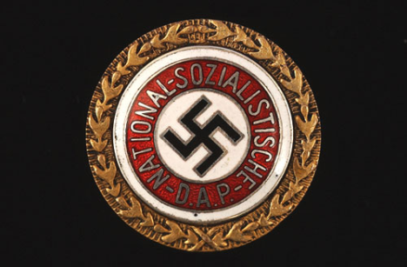
The NSDAP (Nazi Party)
Hitler became leader of the Nazi Party in 1921 and quickly built up the membership of the party.
His powerful speaking ability helped him to do this.
One person who heard him speak in 1922 commented that:
“I was held under a hypnotic spell by the sheer force of his conviction. The intense will of the man, the passion of his sincerity seemed to flow from him to me. It was like a religious conversion.”

Slide 15
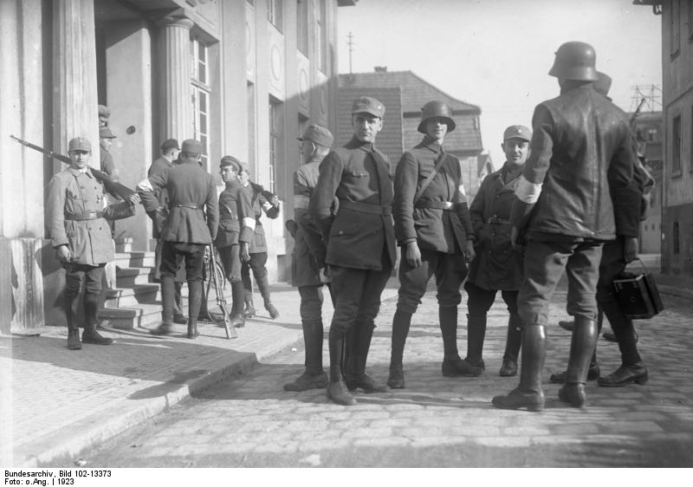
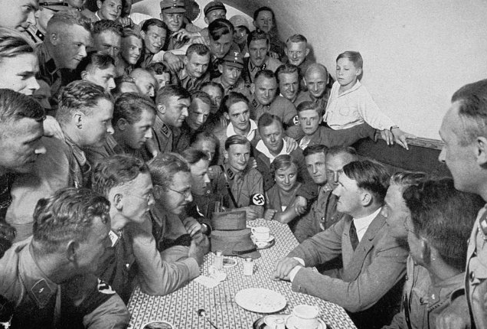
The NSDAP (Nazi Party)
After becoming the party leader Hitler established a private army, the SA or ‘Storm-Troopers’.
Purpose?
To keep order at party meetings
Used in street demonstrations and parades

Slide 16
NSDAP (Nazi Party)
When it was founded the NSDAP was only one of many parties in Germany that were right-wing and nationalist.
These parties opposed the Weimar Republic and the Treaty of Versailles.
They also believed that it was important to keep the German race pure.
However, the NSDAP had an advantage as by 1922 they had around 20,000 members, and by 1923 this had risen to around 55,000 as a result of the hyperinflation crisis.
This gave them more power than the other small parties.

Slide 17
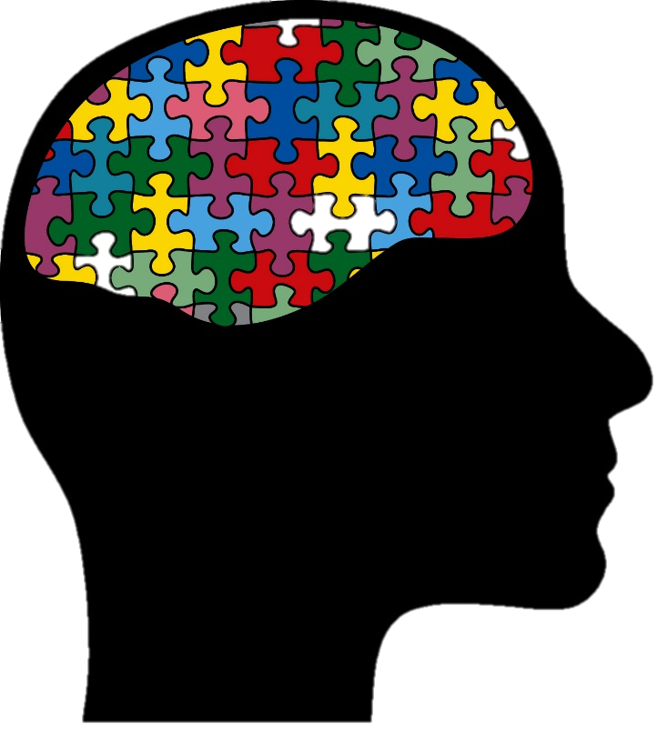
Ideology of the Nazi Party
What did Hitler and the Nazis believe?

Slide 18
1. Treaty of Versailles
Hitler was determined to abolish the Treaty of Versailles.
He also wanted to create a German Reich (empire) to include all members of the German Volk (people) who lived beyond its borders.
All Germans would be united under one leader.
The German army would be rebuilt, all territory reclaimed and Germany would be a power within Europe, respected by other nations.

Slide 19
2. Lebensraum
The German population was growing and needed room to expand.
Hitler said that the German nation needed more Lebensraum (‘living space’).
He was determined to get Lebensraum by conquering land in eastern Europe.
This was connected with his belief that the Aryan race was genetically superior and destined to rule over others.
Hitler believed he had the right to invade eastern Europe and make the Slav peoples Germany's slaves.

Slide 20
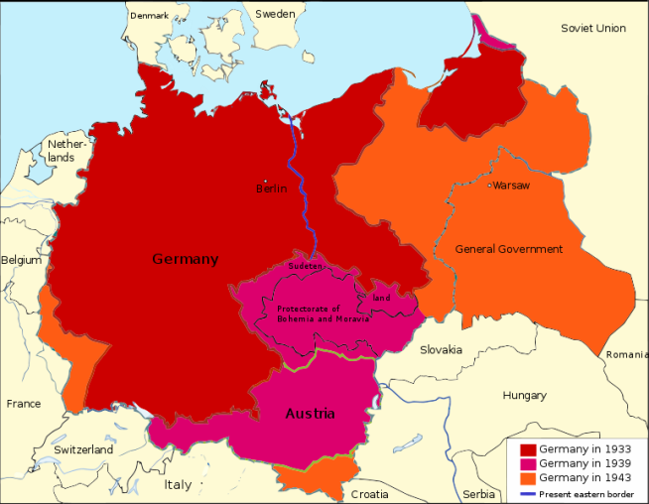

Slide 21
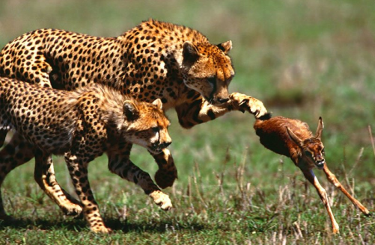
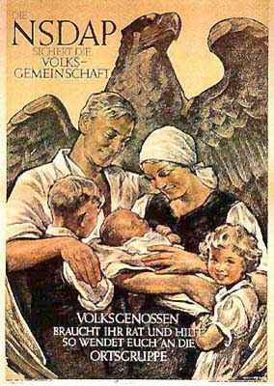
3. Race
Hitler’s ideas centred on the importance of racial purity and on the need for a nation to be prepared to compete with its neighbours in a brutal, uncompromising and ceaseless struggle to survive and to expand – “survival of the fittest”
He believed it was vital to maintain racial purity so that the strong would not be undermined by the blood of the weak.

Slide 22
3. Race
Herrenvolk = Master Race
The Nazis believed that the Aryan race (Germans) was physically and intellectually superior to all other races.
The lowest form of life was the Untermenschen (sub-human) – the Jews, negroes and Slavs.
Interbreeding between races must be prevented.
He believed that the Jews polluted the German blood. That they were to blame for all of Germany’s problems and should be eliminated from German society.

Slide 23

4. Communism
Hitler believed Communism was a Jewish conspiracy to make all races equal and deny the Aryans their rights as the master race.
Hitler blamed the Communists for Germany's defeat in World War One, and he feared that the Communists were trying to take over Germany.
Hitler’s goal was to destroy Communism.

Slide 24
What did Hitler and the Nazis believe?
The foundation of Hitler’s ideology was an intense hatred of the Jews.
He believed that the German race was being weakened by the Jews and that Jews were racially inferior.
Hitler wanted to create a pure German master race, the Aryan race.

Slide 25
Why did people follow Hitler and the Nazis?
Hitler promised the people of Germany that he would solve their problems.
He set out his vision for the future of Germany which would see Germany return to its former prosperity and greatness.
His skills as a speaker ensured that many in Germany believed his promises and his vision whole-heartedly.

